Slide 1
ENSE 470, Milestone 3
ByteThis Software
Taylor Petrychyn, Alwin Baby, and Konstantin Kharitonov
February 1, 2017

Slide 2
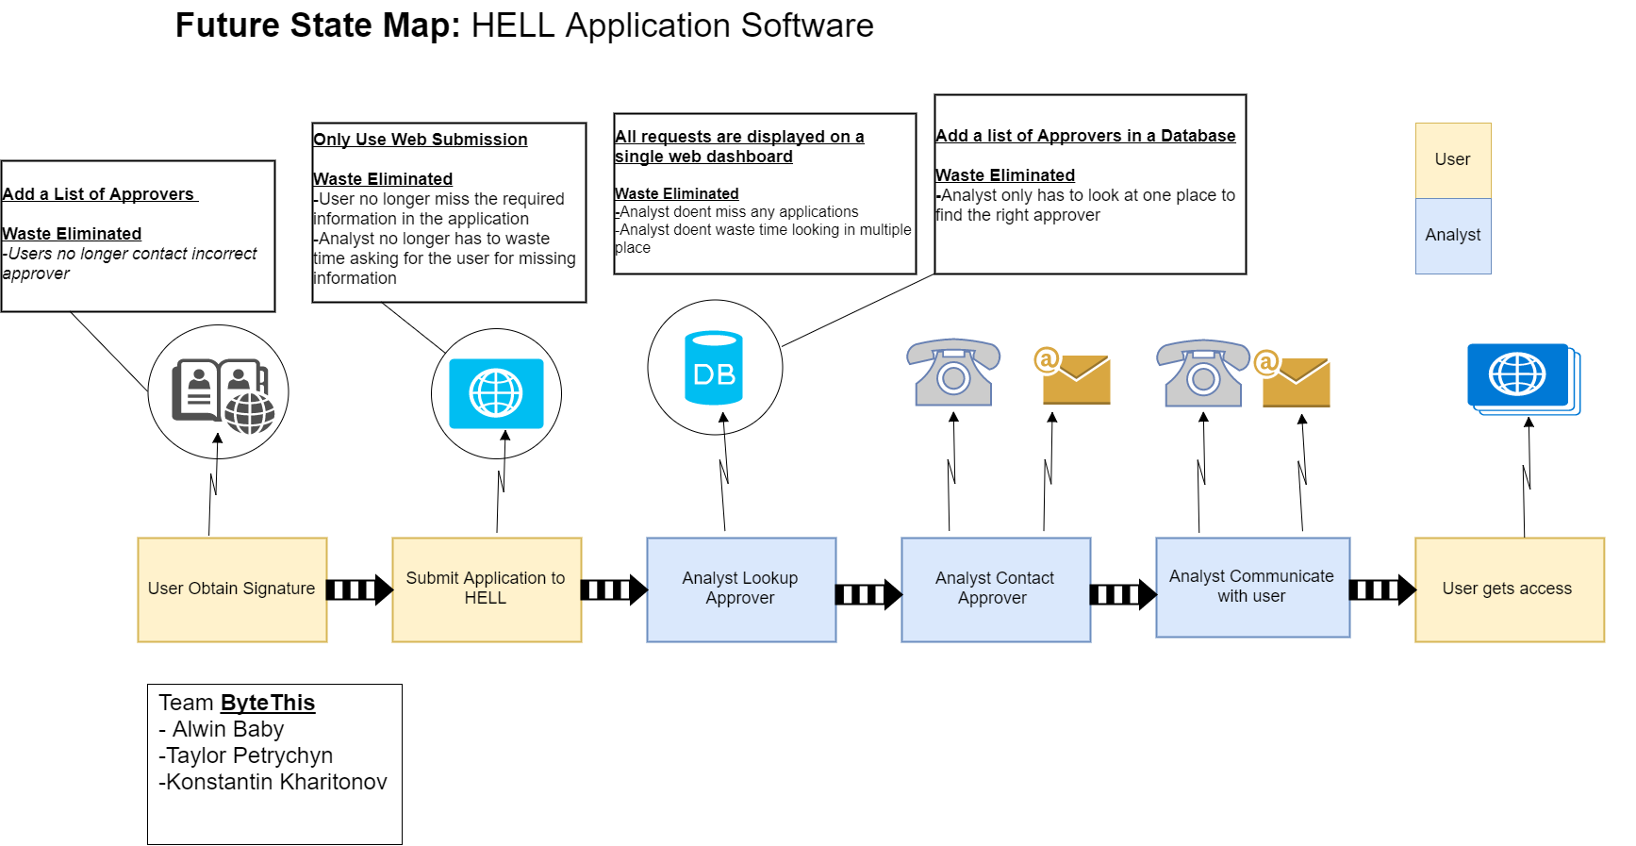

Slide 3
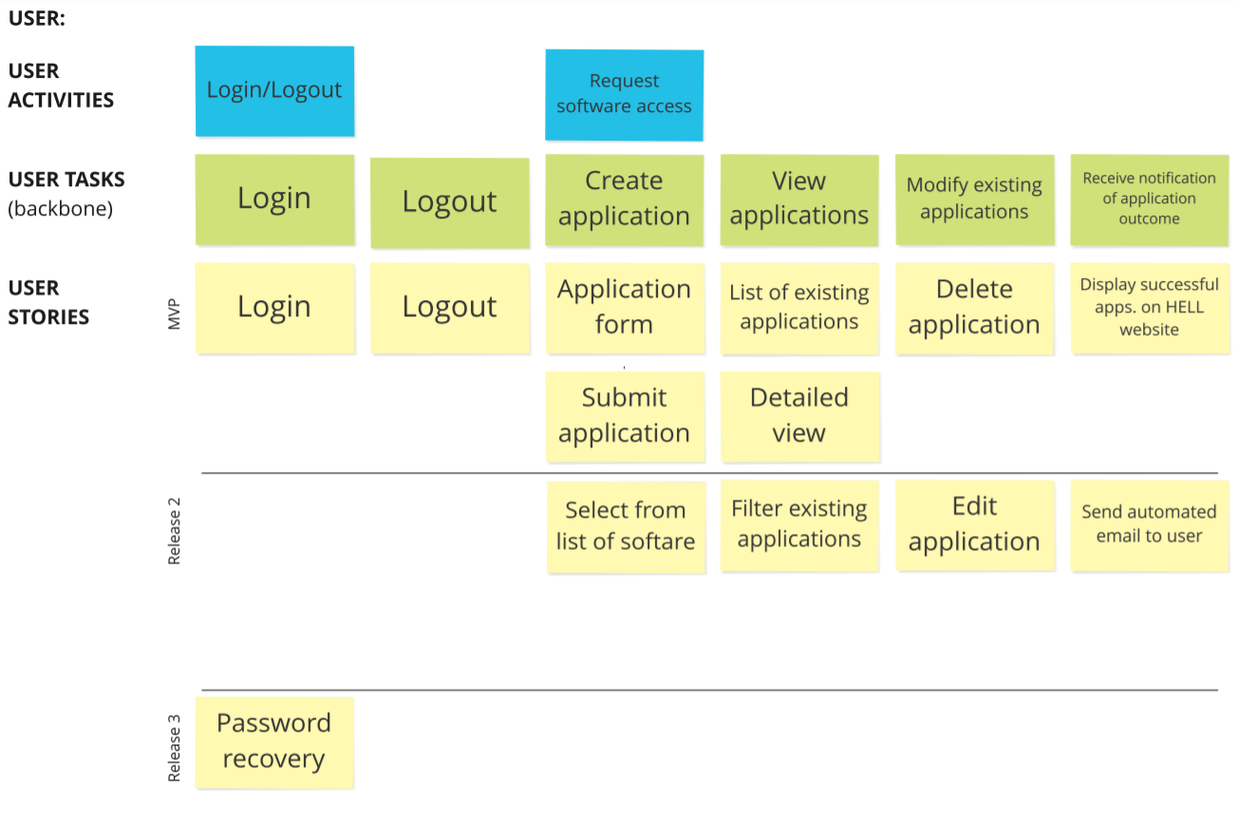

Slide 4
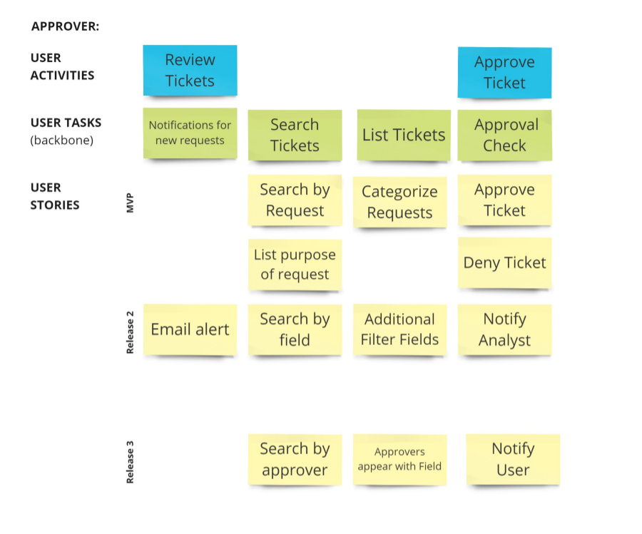

Slide 5
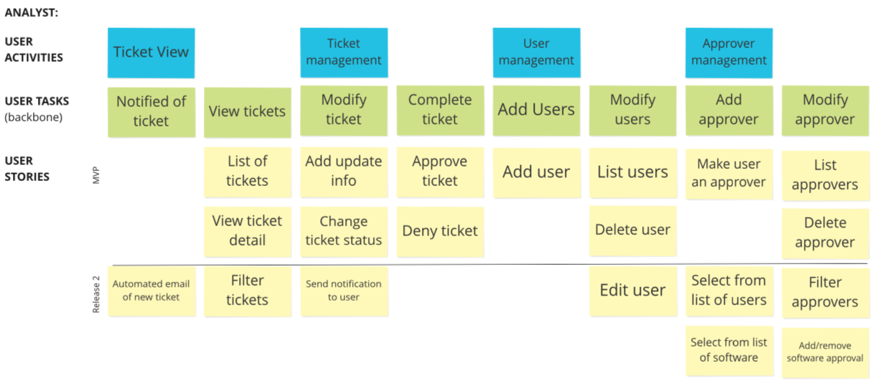

Slide 6
Changes & Misc.
Analyst looks at the application after approval.
Users application goes to approver automatically.

Slide 7
Group reflection
How did you feel about this milestone? What did you like about it? What did you dislike?
  User Story Map was something new. Drawing tool was easy to find.
What did you learn about yourself as you collaborated and worked through this milestone?
  Learned how to create User story map.
How will you use what you have learned going forward?
  Future Assignments and Planning for future Projects
What “stuff & things” related to this milestone would you want help with?
  Fine tuning the user story map

